Slide 1
Chapter 6: Applied Networking
Instructor Materials
IT Essentials v7.0
Notes:
Cisco Networking Academy Program
IT Essentials v7.0
Chapter 6: Applied Networking

Slide 2
Instructor Materials – Chapter 6 Planning Guide
This PowerPoint deck is divided in two parts:
Instructor Planning Guide
Information to help you become familiar with the chapter
Teaching aids
Instructor Class Presentation
Optional slides that you can use in the classroom
Begins on slide #12
Note: Remove the Planning Guide from this presentation before sharing with anyone.
Notes:
2

Slide 3
Chapter 6: Applied Networking
IT Essentials 7.0 Planning Guide
Notes:
Cisco Networking Academy Program
IT Essentials v7.0
Chapter 6: Applied Networking

Slide 4
Check Your Understanding and What Do You Already Know?
Check Your Understanding activities used to be called Interactive Activities. They simply have a new name. They are designed to let students quickly determine if they understand the content and can proceed, or if they need to review.
Check Your Understanding activities do not affect student grades.
Activities listed as What Do You Already Know? are a type of activity in which we ask the student to simply take a guess! It is not meant to evaluate their knowledge. It is only meant to give them a head start in thinking about different topics before they are presented in the course. Students receive addition content in the form of feedback for any answers they select.
What Do You Already Know? activities do not directly affect student grades; however, the feedback may contain content which appears later in quizzes and exams, so it is important that students complete the What Do You Already Know? activities.
There are no separate slides for these activities in the PPT. They are listed in the notes area of the slide that appears before these activities.
Notes:
4

Slide 5
Chapter 6: Activities
What activities are associated with this chapter?
Page # | Activity Type | Activity Name | Optional?
6.1.1.1 | Video Explanation | MAC Addressing | Recommended
6.1.1.2 | Video Explanation | IPv4 Addressing | Recommended
6.1.1.3 | Video Explanation | IPv6 Addressing | Recommended
6.1.1.11 | Check Your Understanding | Network Addressing | Recommended
6.1.2.1 | Packet Tracer | Add Computers to an Existing Network | Recommended
6.1.2.7 | Lab | Configure a NIC to Use DHCP in Windows | Recommended
6.1.3.1 | Video Explanation | Configure a Wired and Wireless Network | Recommended
6.1.3.9 | Packet Tracer | Connect to a Wireless Network | Recommended
6.1.3.10 | Lab | Configure a Wireless Network | Recommended
6.1.4.1 | Video Explanation | Firewall Settings | Recommended
Notes:
5

Slide 6
Chapter 6: Activities (Cont.)
What activities are associated with this chapter?
Page # | Activity Type | Activity Name | Optional?
6.1.4.7 | Packet Tracer | Configure Firewall Settings | Recommended
6.1.4.8 | Lab | Configure Firewall Settings | Recommended
6.1.5.3 | Packet Tracer | Configure IoT Devices | Recommended
6.2.1.8 | Check Your Understanding | Network Troubleshooting Process | Recommended
6.2.2.5 | Lab | Troubleshoot Network Problems
Notes:
6

Slide 7
Chapter 6: Assessment
Students should complete Chapter 6, “Assessment” after completing Chapter 6.
Quizzes, labs, and other activities can be used to informally assess student progress.
Notes:
7

Slide 8
Chapter 6: Best Practices
Prior to teaching Chapter 6, the instructor should:
Complete Chapter 6, “Assessment.”
The objectives of this chapter are:
Configure devices for wired and wireless networks.
Troubleshoot problems and solutions related to networks.
Notes:
8

Slide 9
Chapter 6: Best Practices (Cont.)
This chapter may need to be covered over several class periods.
If there is time, show the videos on addressing or assign as outside class work.
For the MAC address, have students bring up a command prompt, type ipconfig /all, and call on a couple of people to shout out their MAC address. Write on the board to show the common characters and the uniqueness of the last ones. Usually the first part of the MAC address will be the same. Then do the same for the IPv4 address and the IPv6 address.
To further reinforce the concepts of static and dynamic IP addressing, have all students count off starting with the number 1 so each student has a unique number. Then have each one of them bring up the Network and Sharing Center Control Panel > Change adapter settings > right-click on the Ethernet option > Properties > double-click on the Internet Protocol Version 4 (TCP/IPv4) option. Most likely the Obtain an IP address automatically option will be enabled. Have the students select the Use the following IP address option. In the IP address section. Have each student type in 192.168.10.whatever number they counted with at the beginning. Leave the default subnet mask of 255.255.255.0. Click OK two times. Then each student brings up a command prompt and pings another student’s IP address. Have them return the settings to the DHCP option (Obtain an IP address automatically) or whatever was set.
Notes:
9

Slide 10
Chapter 6: Best Practices (Cont.)
If you have wireless access points or routers, put the students in teams with a different set of configuration parameters to configure. Every group should configure the SSID and change the basic security settings from the default values. They should all be taught how to reset the wireless device back to the default at the end of the lesson. Other options to include DHCP, QoS, NAT or port forwarding, firewall settings, security settings, and MAC address filtering. Leave time to share results and “ah ha” moments.
Doing the IoT Packet Tracer in class will be very beneficial to students who might not be able to afford these devices.
Troubleshooting with fake scenarios with someone pretending to have a problem and someone else being the technician is always good. It helps if you provide at least a hint to the type of network problem and let them research a scenario while the “technician” is researching solutions. Role playing is always beneficial to improve communication skills.
Notes:
10

Slide 11
Chapter 6: Additional Help
For additional help with teaching strategies, including lesson plans, analogies for difficult concepts, and discussion topics, visit the ITE Community at: https://community.cisco.com/t5/networking-academy/ct-p/Netacad, or simply go to https://community.cisco.com.
If you have lesson plans or resources that you would like to share, upload them to the ITE Community in order to help other instructors.
Notes:
11

Slide 12
Chapter 6: Applied Networking
IT Essentials v7.0
Notes:
Cisco Networking Academy Program
IT Essentials v7.0
Chapter 6 Applied Networking

Slide 13
Chapter 6 - Sections & Objectives
6.1 Device to Network Connection
Configure devices for wired and wireless networks.
Explain MAC and IP addressing for computer networks.
Configure a NIC for wired and wireless networks.
Configure wireless networking in a small LAN.
Configure firewall settings.
Configure IoT devices.
6.2 Network Troubleshooting
Troubleshoot problems and solutions related to networks.
Explain the six steps of the troubleshooting process for networks.
Troubleshoot common and advanced problems related to networks.
Notes:
13
Cisco Networking Academy Program
IT Essentials v7.0
Chapter 6: Applied Networking

Slide 14
6.1 Device to Network Connection
Notes:
6 – Applied Networking
6.1 – Network Addressing

Slide 15
Network Addressing Video Explanation – MAC Addressing
This is a video explanation about MAC Addressing:
Communication analogy
NIC MAC Address
Physical Address
OUI and Vendor Assigned
Communication on the Same Network
Communication on a Separate Network
Notes:
6.1 – Device to Network Connection
6.1.1 – Network Addressing
6.1.1.1 – Video Explanation – MAC Addressing

Slide 16
Network Addressing Video Explanation – IPv4 Addressing
This is a video explanation about IPv4 Addressing:
Communication analogy
IPv4 Addresses vs. IPv6 Addresses
Decimal vs. Binary vs. Hexadecimal
Subnet Masks
IPv4 Address Network and Host Portions
IPv4 Addressing Example
Notes:
6.1 – Device to Network Connection
6.1.1 – Network Addressing
6.1.1.2 – Video Explanation – IPv4 Addressing

Slide 17
Network Addressing Video Explanation – IPv6 Addressing
This is a video explanation about IPv6 Addressing:
Hexadecimal Segments
Address Compression Rules
IPv6 Address Network and Host Portions
IPv6 Addressing Example
Notes:
6.1 – Device to Network Connection
6.1.1 – Network Addressing
6.1.1.3 – Video Explanation – IPv6 Addressing

Slide 18
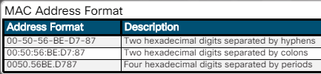
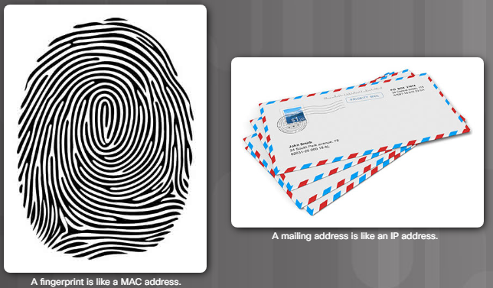
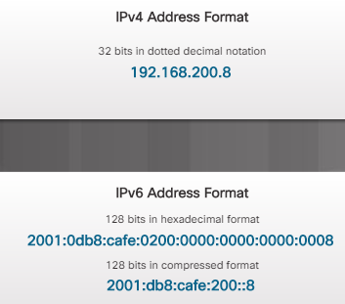
Network Addressing Two Network Addresses
Notes:
6.1 – Device to Network Connection
6.1.1 – Network Addressing
6.1.1.4 – Two Network Addresses

Slide 19
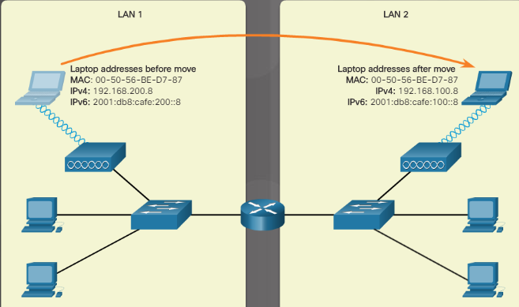
Network Addressing Two Network Addresses (Cont.)
When a laptop is moved to a different network, the MAC address stays the same, but the IPv4 and IPv6 addresses change.
A MAC address is a unique number that is part of the NIC.
IP addresses are assigned by the company or internet provider.
Notes:
6.1 – Device to Network Connection
6.1.1 – Network Addressing
6.1.1.4 – Two Network Addresses (Cont.)

Slide 20
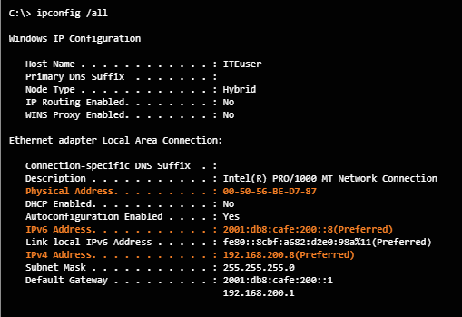
Network Addressing Displaying the Addresses
Use the /all switch with the ipconfig command to see the MAC (physical) address.
Notes:
6.1 – Device to Network Connection
6.1.1 – Network Addressing
6.1.1.5 – Displaying the Addresses

Slide 21
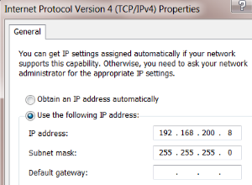
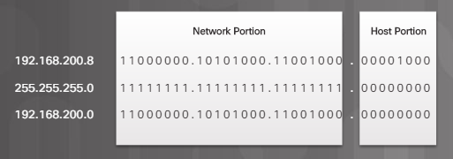
Network Addressing IPv4 Address Format
Two parts of an IP address:
Network
Host
The subnet mask determines which part of the address is the network part.
Network portion of the address due to the subnet mask
Notes:
6.1 – Device to Network Connection
6.1.1 – Network Addressing
6.1.1.6 – IPv4 Address Format

Slide 22
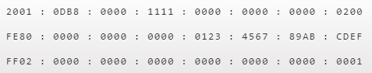
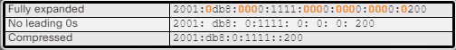
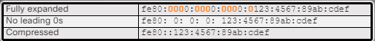
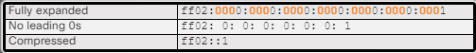
Network Addressing IPv6 Address Format
Rules:
Omit leading 0s – 0db8 can be db8
Omit all 0 segments – use double colons (::)
Notes:
6.1 – Device to Network Connection
6.1.1 – Network Addressing
6.1.1.7 – IPv6 Address Format

Slide 23
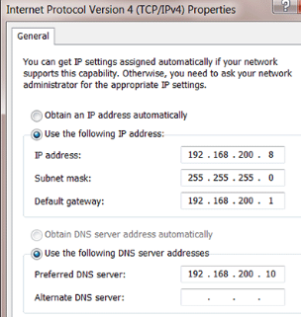
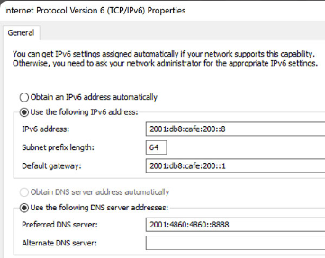
Network Addressing Static Addressing
Static address information needed for communication with other networks and the internet:
IP address
Subnet mask
Default gateway (address of router so information can be sent to other networks)
DNS server (converts domain names or URLs to IP addresses for easy reachability or remote web sites and devices)
Notes:
6.1 – Device to Network Connection
6.1.1 – Network Addressing
6.1.1.8 – Static Addressing

Slide 24
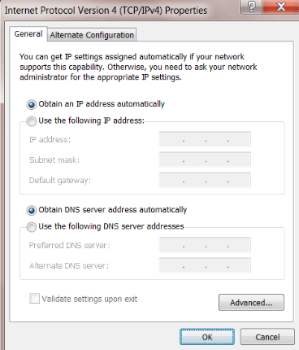
Network Addressing Dynamic Addressing
Use this setting
IP addressing information comes from a DHCP server
Notes:
6.1 – Device to Network Connection
6.1.1 – Network Addressing
6.1.1.9 – Dynamic Addressing

Slide 25
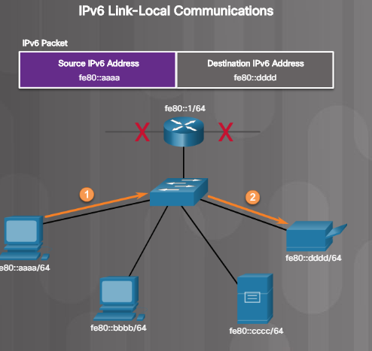
Network Addressing Link-local IPv4 and IPv6 Addresses
IPv4 device uses if the device cannot obtain an IPv4 IP address.
IPv6 device must always have a dynamic or manually configured link-local IPv6 IP address.
Notes:
6.1 – Device to Network Connection
6.1.1 – Network Addressing
6.1.1.10 – Link-local IPv4 and IPv6 Addresses
6.1.1.11 – Check Your Understanding – Network Addressing

Slide 26
Configure a NIC Packet Tracer – Add Computers to an Existing Network
In this Packet Tracer activity, you will configure the computers to use DHCP, configure static addressing, use ipconfig to retrieve host IPv4 information, and use ping to verify connectivity.
Notes:
6.1 – Device to Network Connection
6.1.2 – Configure a NIC
6.1.2.1 – Packet Tracer – Add Computers to an Existing Network

Slide 27
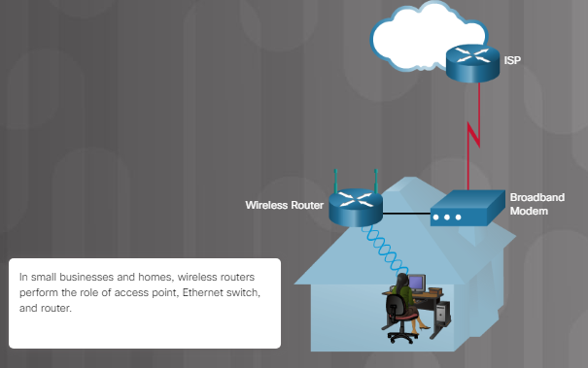
Configure a NIC Network Design
Network components
Network design
Typical Home Network
Notes:
6.1 – Device to Network Connection
6.1.2 – Configure a NIC
6.1.2.2 – Network Design

Slide 28
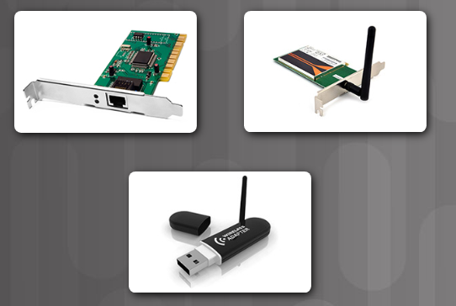
Configure a NIC Selecting a NIC
Wired Ethernet
Wireless Ethernet
Wireless Ethernet
Notes:
6.1 – Device to Network Connection
6.1.2 – Configure a NIC
6.1.2.3 – Selecting a NIC

Slide 29
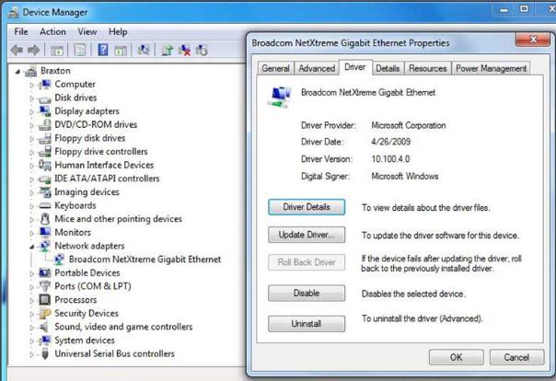
Configure a NIC Installing and Updating a NIC
If installing a wireless NIC, ensure antenna is positioned for optimum reachability
Use Device Manager to view the driver details:
Expand the Network adapters category
Right-click on specific NIC > Properties or Update driver
Notes:
6.1 – Device to Network Connection
6.1.2 – Configure a NIC
6.1.2.4 – Installing and Updating a NIC

Slide 30
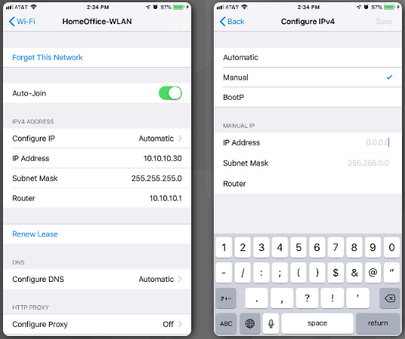
Configure a NIC Configure a NIC
Wireless devices including smart phones also need IP addresses to participate on a wireless network.
Notes:
6.1 – Device to Network Connection
6.1.2 – Configure a NIC
6.1.2.5 – Configure a NIC

Slide 31
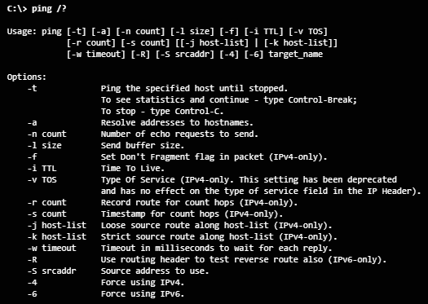
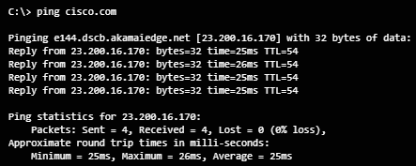
Configure a NIC ICMP
ping command switch options
Internet Control Message Protocol (ICMP) is used to test connectivity and send control and error messages.
The ping command is part of ICMP.
Notes:
6.1 – Device to Network Connection
6.1.2 – Configure a NIC
6.1.2.6 – ICMP

Slide 32
Configure a NIC Lab – configure a NIC to Use DHCP in Windows
In this lab, you will configure an Ethernet NIC to use DHCP to obtain an IP address and test connectivity between two computers.
Notes:
6.1 – Device to Network Connection
6.1.2 – Configure a NIC
6.1.2.7 – Lab – Configure a NIC to Use DHCP in Windows

Slide 33
Configure a Wired and Wireless Network Video Explanation – Configure a Wired and Wireless Network
This is a video explanation about configuring a wired and wireless network:
Connect Cables
Wireless Router Web Page
Change Password
WAN Settings
LAN Settings
Wireless Settings
Connect to the Wireless Network
Notes:
6.1 – Device to Network Connection
6.1.3 – Configure a Wired and Wireless Network
6.1.3.1 – Video Explanation – Configure a Wired and Wireless Network

Slide 34
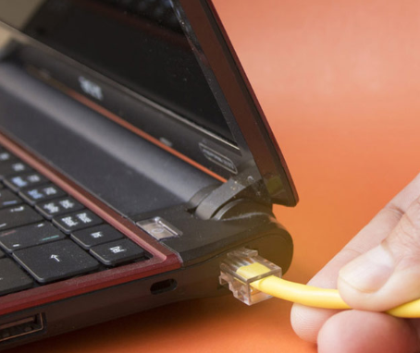
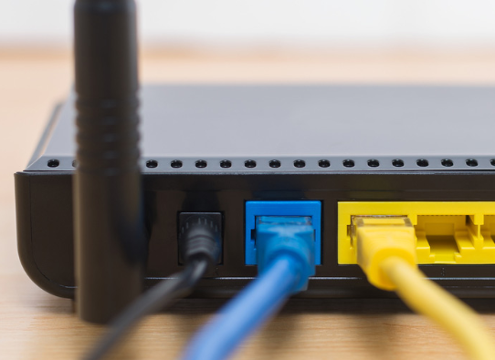
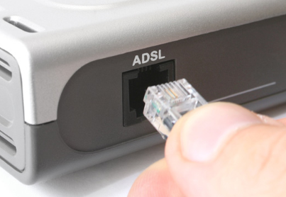
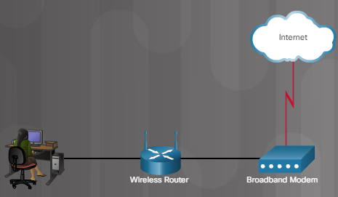
Configure a Wired and Wireless Network Connecting Wired Devices to the Internet
To connect a small office or home wired network device:
Connect the cable to device.
Connect other end of cable to switch (yellow port).
Connect cable between the wireless router (blue port) and the broadband modem.
To modem
To PC
Notes:
6.1 – Device to Network Connection
6.1.3 – Configure a Wired and Wireless Network
6.1.3.2 – Connecting Wired Devices to the Internet

Slide 35
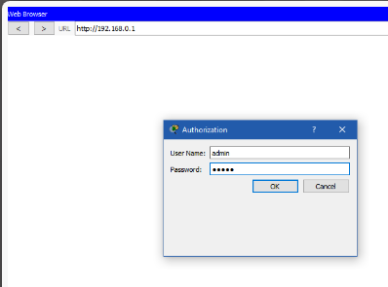
Configure a Wired and Wireless Network Logging into the Router
Open a browser and enter the default IP address of the router.
Change the default username and password immediately.
Notes:
6.1 – Device to Network Connection
6.1.3 – Configure a Wired and Wireless Network
6.1.3.3 – Logging in to the Router

Slide 36
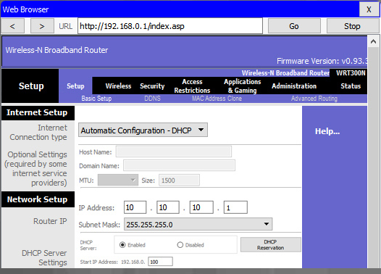
Configure a Wired and Wireless Network Basic Network Setup
Log in to router.
Change the default password.
Log in with new password.
Set the DHCP address range
Renew IP addresses on devices (ipconfig /release and then ipconfig /renew commands).
Change default IP address and log in with new IP address.
Notes:
6.1 – Device to Network Connection
6.1.3 – Configure a Wired and Wireless Network
6.1.3.4 – Basic Network Setup

Slide 37
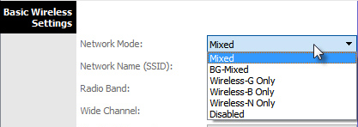
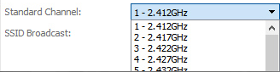
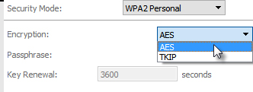
Configure a Wired and Wireless Network Basic Wireless Settings
2.
View WLAN defaults.
Change the network mode.
Configure SSID.
Configure channel.
Configure security mode.
Configure the passphrase.
3.
4.
5.
6.
Notes:
6.1 – Device to Network Connection
6.1.3 – Configure a Wired and Wireless Network
6.1.3.5 – Basic Wireless Settings

Slide 38
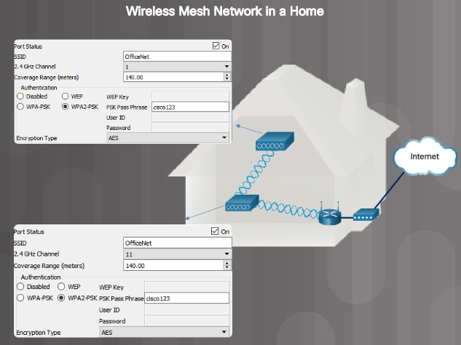
Configure a Wired and Wireless Network Configure a Wireless Mesh Network
Notes:
6.1 – Device to Network Connection
6.1.3 – Configure a Wired and Wireless Network
6.1.3.6 – Configure a Wireless Mesh Network

Slide 39
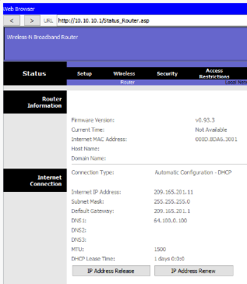
Configure a Wired and Wireless Network NAT for IPv4
Network Address Translation (NAT) converts private IPv4 addresses to Internet-routable public IPv4 addresses.
Notes:
6.1 – Device to Network Connection
6.1.3 – Configure a Wired and Wireless Network
6.1.3.7 – Configure a Wireless Mesh Network

Slide 40
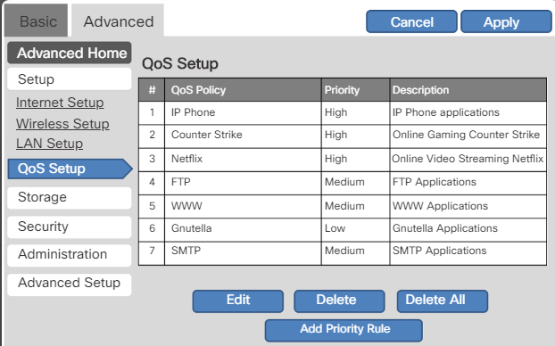
Configure a Wired and Wireless Network Quality of Service
Quality of Service (QoS) configuration allows prioritization of specific traffic types.
Notes:
6.1 – Device to Network Connection
6.1.3 – Configure a Wired and Wireless Network
6.1.3.8 – Quality of Service
6.1.3.9 – Packet Tracer – Connect to a Wireless Network

Slide 41
Configure a Wired and Wireless Network Packet Tracer – Connect to a Wireless Network
In this Packet Tracer activity, you will configure a wireless router and an access point to accept wireless clients and route IP packets. You will also update some of the default settings.
Notes:
6.1 – Device to Network Connection
6.1.3 – Configure a Wired and Wireless Network
6.1.3.9 – Packet Tracer – Connect to a Wireless Network

Slide 42
Configure a Wired and Wireless Network Lab – Configure a Wireless Network
In this lab, you will configure basic settings on a wireless router and connect a PC to router wirelessly.
Notes:
6.1 – Device to Network Connection
6.1.3 – Configure a Wired and Wireless Network
6.1.3.10 – Lab – Configure a Wireless Network

Slide 43
Firewall Settings Video Explanation – Firewall Settings
This is a video explanation about Firewall Settings:
DMZ configuration in LAN
Firewall rules
Notes:
6.1 – Device to Network Connection
6.1.4 – Firewall Settings
6.1.4.1 – Video Explanation – Firewall Settings

Slide 44
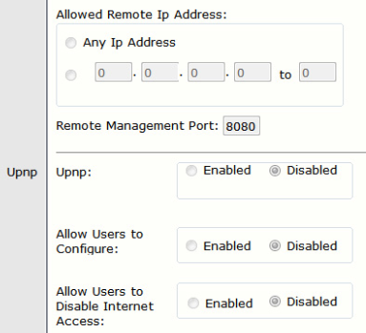
Firewall Settings UPnP
Universal Plug and Play (UPnP) is not secure and is a security risk.
UPnP allows devices to dynamically add themselves to a wireless network without intervention/configuration.
Notes:
6.1 – Device to Network Connection
6.1.4 – Firewall Settings
6.1.4.2 - UPnP

Slide 45
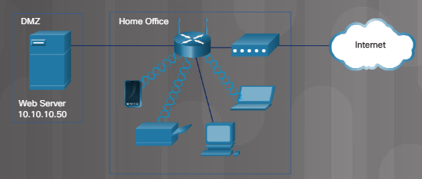
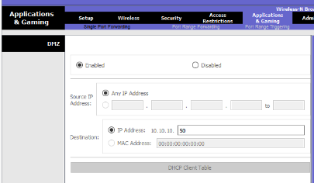
Firewall Settings DMZ
A demilitarized zone (DMZ) is a network that provides services to an untrusted network.
A DMZ often contains servers.
Some wireless routers support the creation of a DMZ.
Notes:
6.1 – Device to Network Connection
6.1.4 – Firewall Settings
6.1.4.3 - DMZ

Slide 46
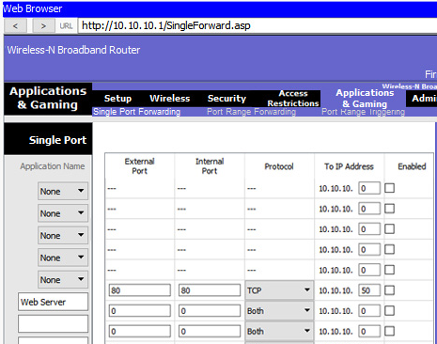
Firewall Settings Port Forwarding
Port forwarding allows traffic to specific ports.
Port triggering allows a temporary opening in the firewall to allow data to specific inbound ports or a port range for an application or game.
Notes:
6.1 – Device to Network Connection
6.1.4 – Firewall Settings
6.1.4.4 – Port Forwarding

Slide 47
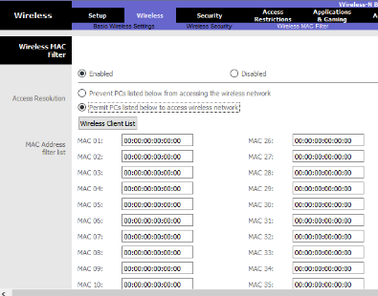
Firewall Settings MAC Address Filtering
MAC Address Filtering is used to specify the MAC addresses that are allowed on the wireless network.
The MAC addresses have not yet been entered into the MAC Address filter list on the wireless router configuration to the left.
Notes:
6.1 – Device to Network Connection
6.1.4 – Firewall Settings
6.1.4.5 – MAC Address Filtering

Slide 48
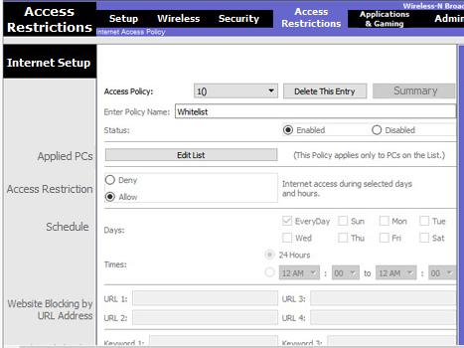
Firewall Settings Whitelisting and Blacklisting
Whitelisting – allow users such as children or employees access to specific IP addresses.
Blacklisting – block known web sites
Notes:
6.1 – Device to Network Connection
6.1.4 – Firewall Settings
6.1.4.6 – Whitelisting and Blacklisting

Slide 49
Firewall Settings Packet Tracer – Configure Firewall Settings
In this Packet Tracer activity, you will configure a wireless router to:
Rely on MAC filtering to increase security
Allow access to a server in the DMZ
Disable the DMZ and configure support for Single Port Forwarding
Notes:
6.1 – Device to Network Connection
6.1.4 – Firewall Settings
6.1.4.7 – Packet Tracer – Configure Firewall Settings

Slide 50
Firewall Settings Lab – Configure Firewall Settings
In this lab, you will configure firewall settings to use MAC address filtering, a DMZ, and single port forwarding on a wireless router to manage the connections and traffic through the wireless router.
Notes:
6.1 – Device to Network Connection
6.1.4 – Firewall Settings
6.1.4.8 – Lab – Configure Firewall Settings

Slide 51
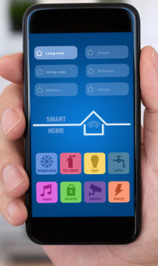
IoT Device Configuration Internet of Things
Internet of Things (IoT) may connect to a pre-existing network or a network of its own.
A smart home contains IoT devices.
Notes:
6.1 – Device to Network Connection
6.1.5 – IoT Device Configuration
6.1.5.1 – Internet of Things

Slide 52
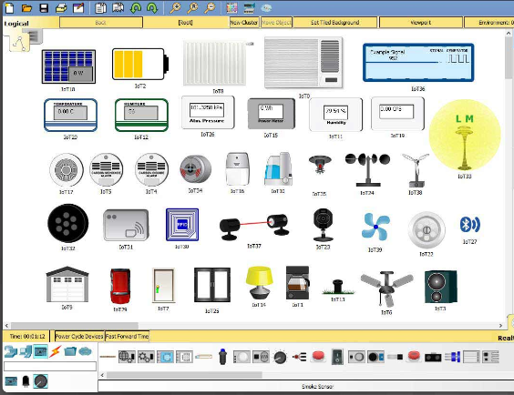
IoT Device Configuration IoT Devices in Packet Tracer
Notes:
6.1 – Device to Network Connection
6.1.5 – IoT Device Configuration
6.1.5.2 – IoT Devices in Packet Tracer

Slide 53
Firewall Settings Packet Tracer – Configure Firewall Settings
In this activity, you have just installed various IoT devices around the house and wish to configure them as a home security system. You will configure the home gateway to use a motion sensor, test and reset security features, and set the air conditioning.
Notes:
6.1 – Device to Network Connection
6.1.5 – IoT Device Configuration
6.1.5.3 – Packet Tracer – Configure IoT Devices

Slide 54
6.2 Network Troubleshooting Process
Notes:
6 – Applied Networking
6.2 – Network Troubleshooting Process

Slide 55
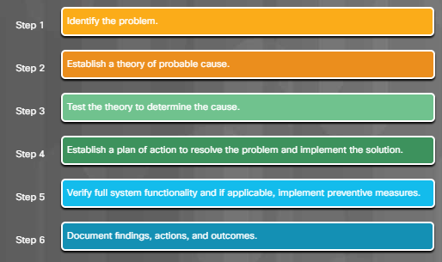
Network Troubleshooting Process The Troubleshooting Process
Notes:
6.2 – Network Troubleshooting
6.2.1 – Network Troubleshooting Process
6.2.1.1 – The Troubleshooting Process

Slide 56
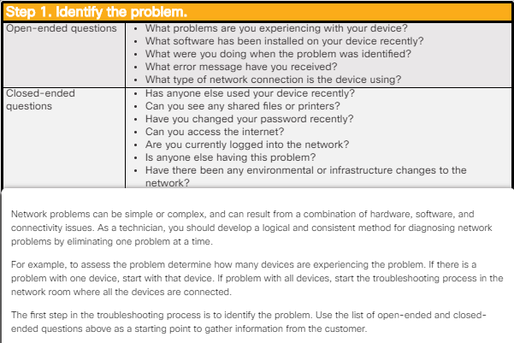
Network Troubleshooting Process The Six Steps to Troubleshoot a Network – Step 1
Notes:
6.2 – Network Troubleshooting
6.2.1 – Network Troubleshooting Process
6.2.1.2 – The Six Steps to Troubleshoot a Network – Step 1

Slide 57
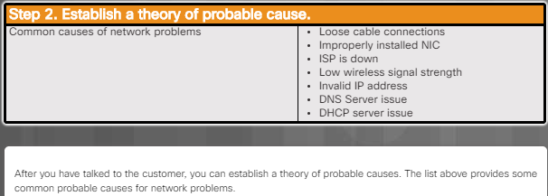
Network Troubleshooting Process The Six Steps to Troubleshoot a Network – Step 2
Notes:
6.2 – Network Troubleshooting
6.2.1 – Network Troubleshooting Process
6.2.1.3 – The Six Steps to Troubleshoot a Network – Step 2

Slide 58
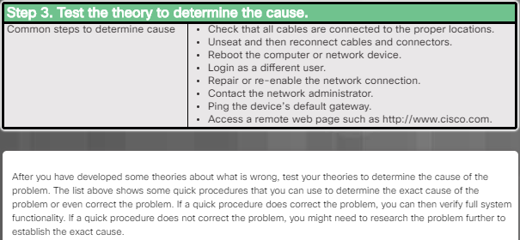
Network Troubleshooting Process The Six Steps to Troubleshoot a Network – Step 3
Notes:
6.2 – Network Troubleshooting
6.2.1 – Network Troubleshooting Process
6.2.1.4 – The Six Steps to Troubleshoot a Network – Step 3

Slide 59
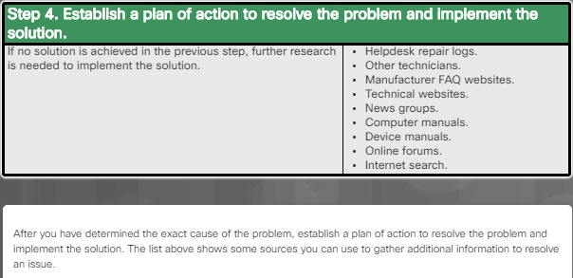
Network Troubleshooting Process The Six Steps to Troubleshoot a Network – Step 4
Notes:
6.2 – Network Troubleshooting
6.2.1 – Network Troubleshooting Process
6.2.1.5 – The Six Steps to Troubleshoot a Network – Step 4

Slide 60
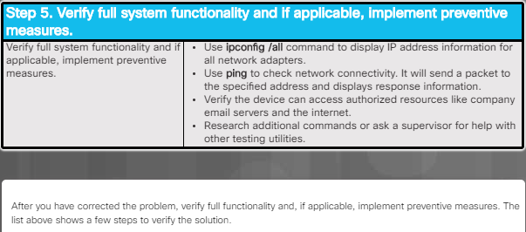
Network Troubleshooting Process The Six Steps to Troubleshoot a Network – Step 5
Notes:
6.2 – Network Troubleshooting
6.2.1 – Network Troubleshooting Process
6.2.1.6 – The Six Steps to Troubleshoot a Network – Step 5

Slide 61
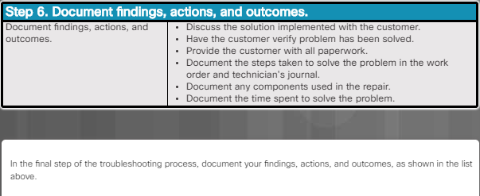
Network Troubleshooting Process The Six Steps to Troubleshoot a Network – Step 6
Notes:
6.2 – Network Troubleshooting
6.2.1 – Network Troubleshooting Process
6.2.1.7 – The Six Steps to Troubleshoot a Network – Step 6
6.2.1.8 – Check Your Understanding – Network Troubleshooting Process

Slide 62
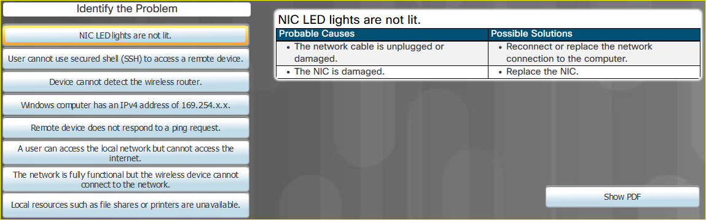
Network Problems and Solutions Common Problems and Solutions for Networking
Notes:
6.2 – Network Troubleshooting
6.2.2 – Network Problems and Solutions
6.2.2.1 – Common Problems and Solutions for Networking

Slide 63
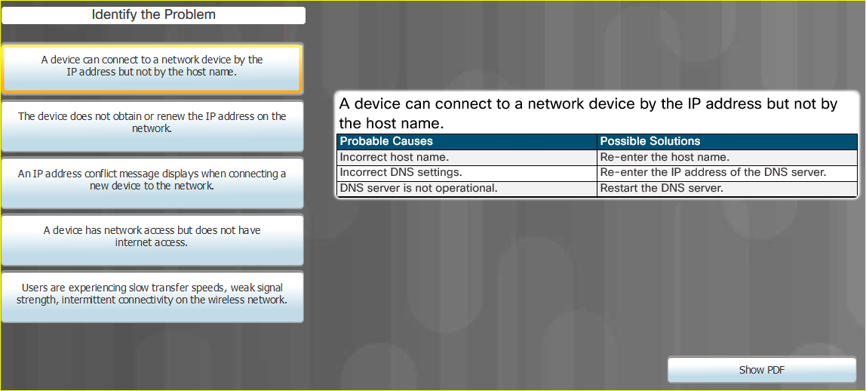
Network Problems and Solutions Advanced Problems and Solutions for Network Connections
Notes:
6.2 – Network Troubleshooting
6.2.2 – Network Problems and Solutions
6.2.2.2 – Advanced Problems and Solutions for Network Connections

Slide 64

Network Problems and Solutions Advanced Problems and Solutions for FTP and Secure Internet Connections
Notes:
6.2 – Network Troubleshooting
6.2.2 – Network Problems and Solutions
6.2.2.3 – Advanced Problems and Solutions for FTP and Secure Internet Connections

Slide 65

Network Problems and Solutions Advanced Problems and Solutions Using Network Tools
Notes:
6.2 – Network Troubleshooting
6.2.2 – Network Problems and Solutions
6.2.2.4 – Advanced Problems and Solutions Using Network Tools

Slide 66
Network Problems and Solutions Lab – Troubleshoot Network Problems
In this lab, you will diagnose the causes of network problems and solve them.
Notes:
6.2 – Network Troubleshooting
6.2.2 – Network Problems and Solutions
6.2.2.5 – Lab – Troubleshoot Network Problems

Slide 67
6.3 Chapter Summary

Slide 68
Chapter 6: Applied Networking Summary
6.1 Device to Network Connection
Configure devices for wired and wireless networks.
Explain MAC and IP addressing for computer networks.
Configure a NIC for wired and wireless networks.
Configure wireless networking in a small LAN.
Configure firewall settings.
Configure IoT devices.
6.2 Network Troubleshooting
Troubleshoot problems and solutions related to networks.
Explain the six steps of the troubleshooting process for networks.
Troubleshoot common and advanced problems related to networks.
Notes:
68
Cisco Networking Academy Program
IT Essentials v7.0
Chapter 6: Applied Networking

Slide 69
Section 6.3 New Terms and Commands
MAC address IPv4 address IPv6 address Static address Dynamic address Link-local address ICMP DHCP Nat for IPv4 QoS | Firewall UPnP DMZ Port forwarding Port triggering MAC address filtering Whitelist Blacklist IoT
Notes:
Chapter 6 - New Terms and Commands

